Slide 1
Lab 1 Update
2.24.21
Kylie Outlaw & Maria Abbasi

Slide 2
Loop Timing
Task #4 Implementation
TIM2 on PA0
Count-up timer
Period of 100,000
Pre-scalar of 83
Every clock tick is 1 microsecond
Struct objects used to keep track of different loops’ timing
Total elapsed time stored using a uint32_t
Number of loops tracked using a uint16_t counter
Averages based on 65,535 consecutive loop timings for inner/outer loops
Averages based on 30 consecutive loop timings for the blink loop

Slide 3
Loop Timing
Task #4 Implementation
New “Loop_timer.h” and “Loop_timer.c” files
Holds data and functions for the “loop_timer” struct
Init, begin, stop, reset, print functions
Start tick
End tick
Total time
Number of loops completed
Each loop is measured using a uint16_t counter
Averages based on 65,535 consecutive loop timings

Slide 4
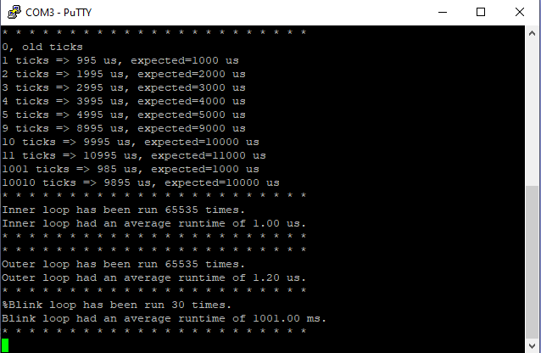
Loop Timing
- Adjusted the main.c calibration to test TIM2 ticks.
- Looking at the output, 1000 clock ticks match 1 HAL tick .
- HAL tick is set up by the system so that each tick is 1ms, or 1/1000 of the processor clock speed.
- The inner loop and outer loops are timed automatically in the code and the average runtimes are output to COM3.
- The inner loop runs at 1.0us average.
- The outer loop runs at 1.2us average.
- The blink loop runs at 1001.00ms, or 1.001s on average.
- This is slightly higher than expected.
Image: COM3 output

Slide 5
Scheduler Priority

Slide 6
Current Schedule Priority
Sch_basic.c - sch_loop()
Polled tasks – checks tasks in loop for hardware conditions
First scheduled, first checked, first executed
ADC ➡ UART Rx ➡UART Tx

Slide 7
Current Schedule Priority
Tasks_lab_1.c - sch_create_timeout()
Based on tick timeout
Higher priority than polling loop
Every ~1s LED toggles

Slide 8
Scheduling Approach
Asynchronous events handled by hardware interrupts
HAL_GPIO_EXTI_Callback();
Break tasks into priority groups
HAL_NVIC_SetPriority() : 0 to 15
If multiple asynchronous interrupts occur at same time, highest priority gets completed first

Slide 9
Scheduling Approach
Synchronous events / periodic tasks handled by timer interrupts
Set up timer with interrupt at each period time
Set HAL_TIM_Period_ElapsedCallback() to process
Will need the period of all synchronous / periodic tasks

Slide 10
Scheduling Approach
Application – data processor and transmitter
Frequent UART Tx calls with many bytes of data in main()
In general, favoring interrupts over polling…
Allows code to prioritize interrupt events & react quicker to user input
Offloads to hardware to reduce load on software for situations with a ‘busy’ main()
Reduces cycle time
Utilizes more components of the MCU

Slide 11
Questions?

